Slide 1



Slide 2



01CE1301 – Data Structure
Unit - 5
Hashing & Collision
Prof. Chirag Bhalodia
Department of Computer Engineering

Slide 3


Outline
Hashing Concepts and methods
Hash Table Methods
Introduction of Hash Functions
Collision in Hashing
Collision-Resolution Techniques

Slide 4

Hashing Concepts & Methods

Slide 5
Hashing Concepts & Methods
Hashing: Hashing is an important data structure designed to solve the problem of efficiently finding and storing data in an array.
For example, if you have a list of 20000 numbers, and you have given a number to search in that list- you will scan each number in the list until you find a match.
Hash Function: It is a technique of mapping a large chunk of data into small tables using a hashing function.
Hash function is also known as the message digest function.
Hash Table: Hash table is one of the most important data structures that uses a special function known as a hash function that maps a given value with a key to access the elements faster.
A Hash table is a data structure that stores some information, and the information has basically two main components, i.e., key and value. The hash table can be implemented with the help of an associative array.

Slide 6
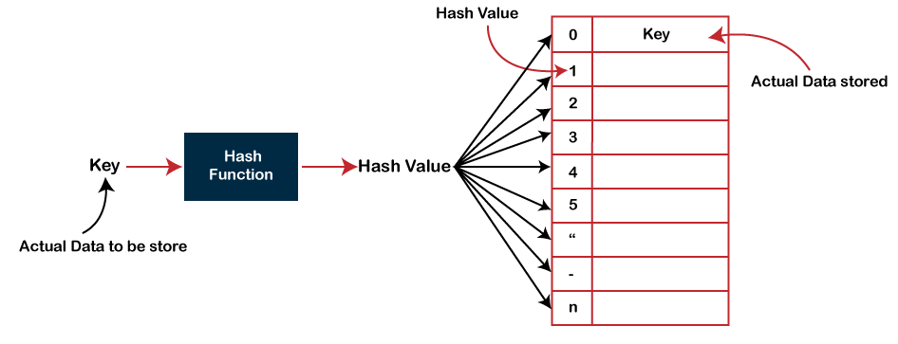
Hashing Concepts & Methods
In Hashing technique, the hash table and hash function are used. Using the hash function, we can calculate the address at which the value can be stored in hash table.
Key: Key is the raw data that has to be hashed in a hash table.
Hash Key = Key Value % Number of Slots in the Table
The main idea behind the hashing is to create the (key/value) pairs. If the key is given, then the algorithm computes the index at which the value would be stored. It can be written as:

Slide 7
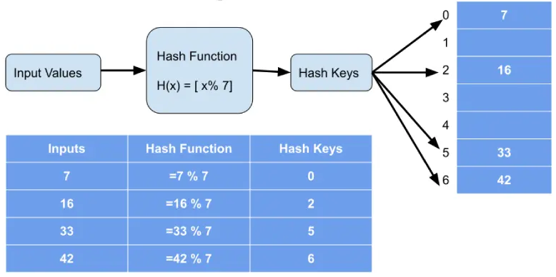
Hashing Concepts & Methods
Example 1:
The main idea behind the hashing is to create the (key/value) pairs. If the key is given, then the algorithm computes the index at which the value would be stored. It can be written as:

Slide 8
Hashing Concepts & Methods
Example 2:
Position (hash = key length) | Key | Value
1
2
3
4
5 | Italy | Rome
6 | France | Paris
7 | England | London
8
9 | Australia | Canberra
10
11 | Switzerland | Berne
Key | Value
Italy | Rome
France | Paris
England | London
Australia | Canberra
Switzerland | Berne

Slide 9
Hashing Concepts & Methods
Example 3: Find the array index of given data. Table size is 20.
(Key, Value)
(1,20) (2,70) (42,80) (4,25) (12,44) (14,32) (17,11) (13,78) (37,98)
Sr. No. | Key | Hash | Array Index
1 | 1 | 1 % 20 = 1 | 1
2 | 2 | 2 % 20 = 2 | 2
3 | 42 | 42 % 20 = 2 | 2
4 | 4 | 4 % 20 = 4 | 4
5 | 12 | 12 % 20 = 12 | 12
6 | 14 | 14 % 20 = 14 | 14
7 | 17 | 17 % 20 = 17 | 17
8 | 13 | 13 % 20 = 13 | 13
9 | 37 | 37 % 20 = 17 | 17

Slide 10
Hash Table Methods

Slide 11
Hash Table Methods
There are two different forms of hashing.
Open hashing or external hashing
Open or external hashing, allows records to be stored in unlimited space (could be a hard disk).
It places no limitation on the size of the tables.
Close hashing or internal hashing
Closed or internal hashing, uses a fixed space for storage and thus limits the size of hash table.

Slide 12
Open Hashing Data Structure
The basic idea is that the records [elements] are partitioned into B classes, numbered 0,1,2 … B-1.
A Hashing function f(x) maps a record with key x to an integer value between 0 and B-1.
Each bucket in the bucket table is the head of the linked list of records mapped to that bucket.
Bucket
Table
0
1
.
.
.
B-1
The open hashing data organization
List of Elements

Slide 13
Close Hashing Data Structure
A closed hash table keeps the elements in the bucket itself.
Only one element can be put in the bucket.
If we try to place an element in the bucket and find it already holds an element, then we say that a collision has occurred.
In case of collision, the element should be rehashed to alternate empty location within the bucket table.
In closed hashing, collision handling is a very important issue.
0
1
2
3
4
5
A
C
B

Slide 14
Introduction of hash Functions

Slide 15
Introduction of Hash Functions
Hash Function: It is a technique of mapping a large chunk of data into small tables using a hashing function.
Hash function is also known as the message digest function.
Characteristics of a Good Hash Function
A good hash function avoids collisions.
A good hash function tends to spread keys evenly in the array.
A good hash function is easy to compute.

Slide 16
Introduction of Hash Functions
Different hashing functions
Division-Method
Midsquare Method
Folding Method
Digit Analysis Method

Slide 17
Division Method
In this method we use modular arithmetic system to divide the key value by some integer divisor m (may be table size).
It gives us the location value, where the element can be placed.
We can write, L = (K mod m),
L = location in table/file
K = key value
m = table size/number of slots in file
Example: Suppose, k = 23, m = 10 then
L = (23 mod 10) = 3 = 3
The key whose value is 23 is placed in 3rd location.

Slide 18
Midsquare Method
In this case, we square the value of a key and take the number of digits required to form an address, from the middle position of squared value.
Suppose a key value is 16
Its square is 256
Now if we want address of two digits
We select the address as 56 (i.e. two digits starting from middle of 256)
Example: Suppose a key value is 60. Suppose the hash table has 100 memory locations. So r=2 because two digits are required to map the key to the memory location.
k = 60
k x k = 60 x 60 = 3600
h(60) = 60
The hash value obtained is 60.

Slide 19
Folding Method
This method involves two steps:
Step-1: Divide the key-value k into a number of parts i.e. k1, k2, k3,….,kn, where each part has the same number of digits except for the last part that can have lesser digits than the other parts.
Step-2: Add the individual parts. The hash value is obtained by ignoring the last carry if any.
Formula:
k = k1, k2, k3, k4, ….., kn
s = k1+ k2 + k3 + k4 +….+ kn
h(K)= s
Here, s is obtained by adding the parts of the key k.

Slide 20
Folding Method
Example: Key = 12345678. Perform folding method of hash function. (i.e., Digit = 2)
Here actual values of each parts of key are added
Suppose, the key is : 12345678, and the required address is of two digits,
Break the key into: 12, 34, 56, 78
Add these, we get 12 + 34 + 56 + 78 : 180, ignore first “1” we get 80 as location

Slide 21
Digital Analysis Method
Here we make a statistical analysis of digits of the key, and select those digits (of fixed position) which occur quite frequently
Then reverse or shifts the digits to get the address
For example,
The key is : 9861234
If the statistical analysis has revealed the fact that the third and fifth position digits occur quite frequently,
We choose the digits in these positions from the key
So we get, 62. Reversing it we get 26 as the address

Slide 22
Collision in Hashing

Slide 23
Collision in Hashing
Collision resolution is the main problem in hashing.
A collision occurs when more than one value to be hashed by a particular hash function, hash to the same slot in the table or data structure (hash table) being generated by the hash function.
A hash collision or hash clash is when two pieces of data in a hash table share the same hash value.
Hashing collisions can have negative impacts on the performance, security, and integrity of the data and the system.

Slide 24
Collision Resolution Techniques

Slide 25
Collision Resolution Techniques
Collision resolution is the main problem in hashing.
If the element to be inserted is mapped to the same location, where an element is already inserted then we have a collision and it must be resolved.
There are several strategies for collision resolution. The most commonly used are :
Separate chaining - used with open hashing
Open addressing - used with closed hashing

Slide 26
Separate Chaining Method
In this strategy, a separate list of all elements mapped to the same value is maintained.
Separate chaining is based on collision avoidance.
If memory space is tight, separate chaining should be avoided.
Additional memory space for links is wasted in storing address of linked elements.
Hashing function should ensure even distribution of elements among buckets; otherwise the timing behaviour of most operations on hash table will deteriorate.

Slide 27
Separate Chaining Method
0
1
2
3
4
5
6
7
8
9
10
50
12
32
62
A Separate Chaining
Hash Table
4
24
7
9
69

Slide 28
Example - Separate chaining
Example : The integers given below are to be inserted in a hash table with 5 locations using chaining to resolve collisions. Construct hash table and use simplest hash function.
1, 2, 3, 4, 5, 10, 21, 22, 33, 34, 15, 32, 31, 48, 49, 50
An element can be mapped to a location in the hash table using the mapping function key % 10
0
1
2
3
4
5
10
50
15
Hash Table Location | Mapped elements
0
1
2
3
4
5
, 15
, 50
, 10
1
21
31
1
, 21
, 31
2
, 22
, 32
2
22
32
3
, 33
, 48
3
33
48
4
, 34
, 49
4
34
49
Hash Table

Slide 29
Open Addressing Method
Separate chaining requires additional memory space for pointers.
Open addressing hashing is an alternate method of handling collision.
In open addressing, if a collision occurs, alternate cells are tried until an empty cell is found.
Linear probing
Quadratic probing
Double hashing.

Slide 30
Linear Probing
In linear probing, whenever there is a collision, cells are searched sequentially (with wraparound) for an empty cell.
Fig. shows the result of inserting keys {5,18,55,78,35,15} using the hash function (f(key)= key%10) and linear probing strategy.
 | Empty Table | After 5 | After 18 | After 55 | After 78 | After 35 | After 15
0
1
2
3
4
5
6
7
8
9
15
5
5
5
5
5
5
55
55
55
55
35
35
18
18
18
18
18
78
78
78

Slide 31
Linear Probing
Linear probing is easy to implement but it suffers from "primary clustering"
When many keys are mapped to the same location (clustering), linear probing will not distribute these keys evenly in the hash table.
These keys will be stored in neighbourhood of the location where they are mapped.
This will lead to clustering of keys around the point of collision

Slide 32
Quadratic probing
One way of reducing "primary clustering" is to use quadratic probing to resolve collision.
Suppose the "key" is mapped to the location j and the cell j is already occupied.
In quadratic probing, the location j, (j+1), (j+4), (j+9), ... are examined to find the first empty cell where the key is to be inserted.
This table reduces primary clustering.
It does not ensure that all cells in the table will be examined to find an empty cell.
Thus, it may be possible that key will not be inserted even if there is an empty cell in the table.

Slide 33
Double Hashing
This method requires two hashing functions f1 (key) and f2 (key).
Problem of clustering can easily be handled through double hashing.
Function f1 (key) is known as primary hash function.
In case the address obtained by f1 (key) is already occupied by a key, the function f2 (key) is evaluated.
The second function f2 (key) is used to compute the increment to be added to the address obtained by the first hash function f1 (key) in case of collision.
The search for an empty location is made successively at the addresses
f1(key) + f2(key),
f1(key) + 2 * f2(key),
f1 (key) + 3 * f2(key),...

Slide 34

Thank
You

